Slide 1

Universal Approximation Theorem
Any continuous function f: [0, 1]n −→ [0, 1] can be
approximated arbitrarily well by a neural network
with at least 1 hidden layer with a finite number of
weights.

Slide 2
Details
Proposed in the 1980’s notably by George Cybenko, Kurt Hornik and Stuart E.Dreyfus
Formalised as the Universal Approximation Theorem(UAT) in Cybenko’s paper “Approximation by superposition of a sigmoidal function”
The theorem claimed that feedforward neural networks with an activation function can be used to approximate any continuous function

Slide 3
Significance
UAT popularised the use of neural networks to approximate even very complex functions
A key reason for the versatility and effectiveness of neural networks in various applications.
Explains how neural networks can find relationships between inputs outputs even when the actual function in unknown.

Slide 4
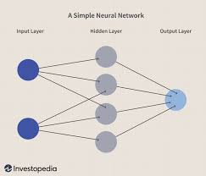
Neural Networks
A neural network is made of interconnected neurons.
Each neuron is a mathematical function applied on the input
The function applied varies based on parameters of each neuron.
Parameters are altered during training so that the result resembles the training data

Slide 5
Activation Functions
Activation functions are the mathematical functions applied by neurons.
They introduce non-linearity to the outputs of the neural network.
Enables neural networks to approximate non-linear functions.
By making the output of each neuron independent and compounds the results for the output.

Slide 6
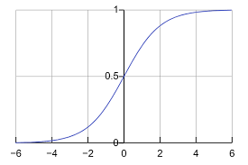
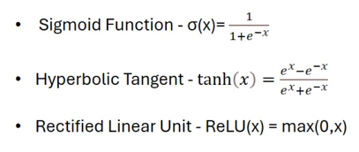
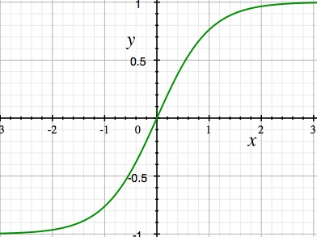
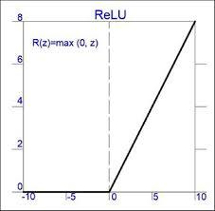
Activation Functions

Slide 7
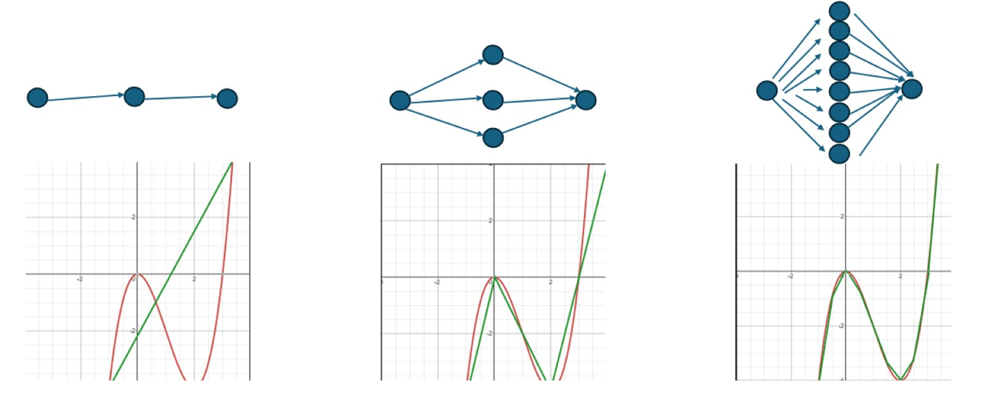
Visual Representation
Approximate
Function
1 neuron
3 neurons
8 neurons

Slide 8
Training
The parameters in neural networks are called weights and biases.
A weight is a multiplier applied onto the input
A bias is an addition applied onto the input
Weights and Biases are optimised during training through back propagation.

Slide 9
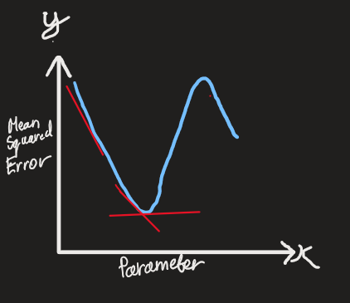
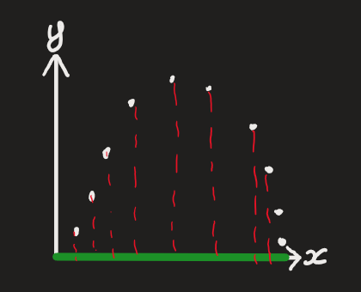
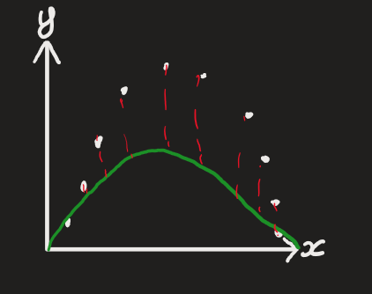
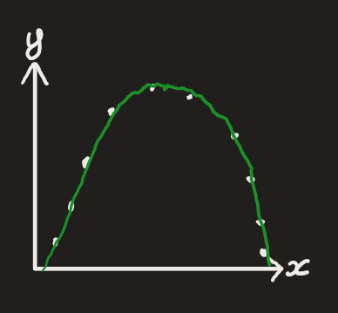
Backpropagation
Using the data set, we work backwords assigning values to parameters and compare output from the network, to the dataset. We change the parameter values till we minimise the error function

Slide 10
Applications of Neural Networks
Machine Learning & Artificial Intelligence
Image and Video Processing
Natural Language Processing
Control Systems

Slide 11
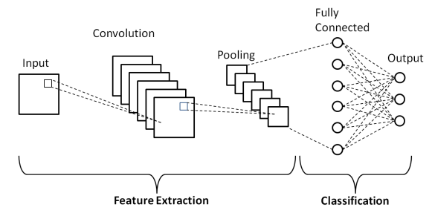
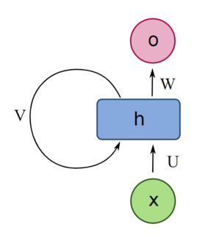
Types of Neural Networks
Convolutional neural networks(CNN), optimised for image processing & identification, by looking for patterns in images that resemble objects using layers of filters. Instead of analysing individual pixel data.
Recurrent neural networks(RNN), optimised for sequential data by having feedback loops in its layers, allowing it to remember previous inputs.

Slide 12
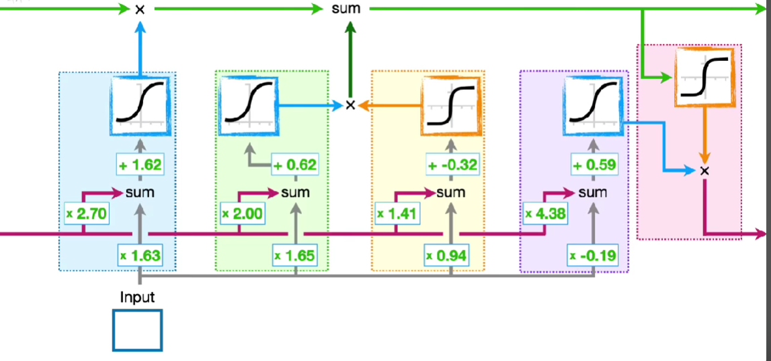
Long Short-Term Memory

